Slide 1
Deep Learning Stock Market Analysis
Eric Escareno
Christian Galleisky
Irvin Budwal
Joseph Lopez

Slide 2
Introduction
What are we investigating? Why is it interesting?
Market psychology paired with deep learning can give us greater insight into how and when we should make trades. This is interesting to our group as most of us have very little investing experience so if novices can figure out how to leverage deep learning effectively there are many more possibilities.
The gap we are trying to fill is that of people who are inexperienced with investing, want to follow market trends, and want to be able to identify investment opportunities while lessening the potential pitfalls in doing so.

Slide 3
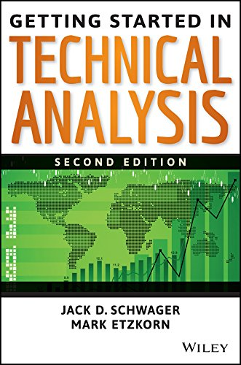
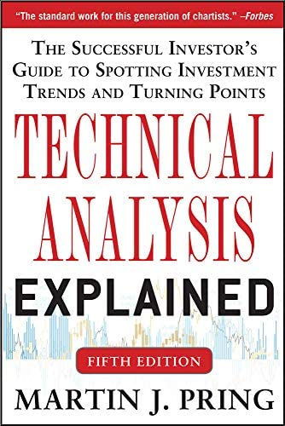
What reading will you examine to provide context and background?
Getting Started in Technical Analysis by Jack Schwager. Technical Analysis explained by Martin Pring. Both books give detail on technical analysis which can be used to make better predictions in stock price.

Slide 4
Data and Approach
Various APIs exist for trading stocks
Yahoo finance API appears to be a reliable/approachable choice (also free)
Though limited in options, may provide enough tools that we need
Alpha Vantage API also appears approachable and can code in python
May require payment for other premium features
Obtain large datasets to train our model:
https://www.kaggle.com/jacksoncrow/download-nasdaq-historical-data/notebook
We will try to get current data by either web scraping where possible or trying a script that collects the data.
https://www.kaggle.com/datasets/jacksoncrow/stock-market-dataset/discussion/188637
If we cannot find a means to quickly collect new data then we will use existing data to build upon.
Our model is meant to measure the emotional state of the market
Not just when to trade/take advantage of the market
Observe how the market feels about a certain share

Slide 5
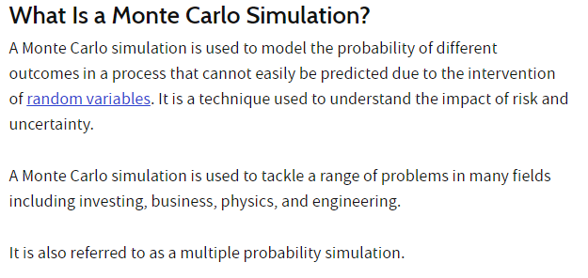
Method/Algorithm
https://www.investopedia.com/terms/m/montecarlosimulation.asp - The Monte Carlo Simulation
Notes:
https://www.kaggle.com/code/artemburenok/stock-analysis-monte-carlo-build-portfolio

Slide 6
How we build on the method? Metrics
There are existing implementations which we can build off of and tweak. Most likely this will require adding different forms of data to include as context. These can include:
Classical Economic indicators; capacity utilization, industrial production, inventories growth/contraction, unemployment rate, participation rate, savings rate, income growth rate, disposable income growth/contraction, etc…
Classical Business metrics: Price to earnings, price to earnings and growth, gross margin, operating income, Earnings before taxes interest and deductions (EBITDA), profit margin, Earnings per share, long term debt, assets, liabilities, assets minus liabilities, etc…
Classical stock chart ideas; shapes of stock price graphs and shapes of various stock chart metrics like RSI and Stochastic Oscillator, etc…

Slide 7
How will we evaluate our results?
We will evaluate our results by checking whether our model makes accurate predictions. We learned necessary technical analysis skills, we researched which market psychology is our project an aspect of, and we strived to make our own predictions to compare against. Our results should be representable as plots and we should be able to compare the accuracy of our predictions across sample sizes to tweak our activation function. The ultimate goal is to make the model as accurate as possible.

Slide 8
Data
Two data sets to utilize and study
Historical daily prices and volumes of all U.S. stocks and ETFs
Historical daily prices of Nasdaq-traded stocks and ETFs
First dataset is expansive, but only includes brute-force data up to year 2017
Second dataset is equally as expansive, but is more up to date
Latest update to dataset was in 2020
Provides data collection script and other tools to update dataset
Both sets are delimited files, easy to utilize within colab (CSV)

Slide 9
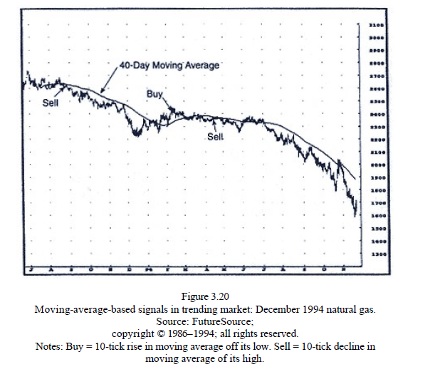
Technical Analysis
Moving averages can provide valuable insight when stocks are relatively stable.
Notes:
Page 48, Getting Started In Technical Analysis

Slide 10
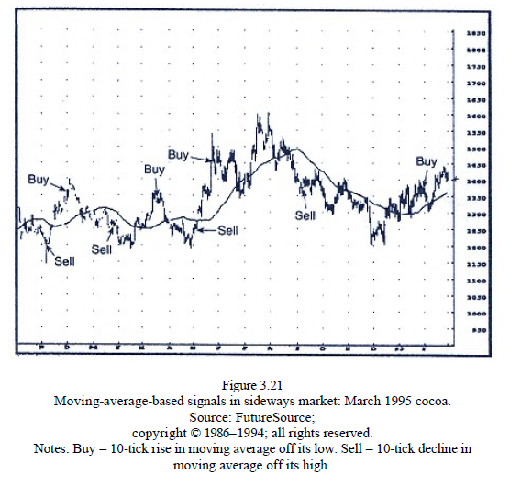
Technical Analysis
Moving averages can lead to poor predictions in an unstable stock price.

Slide 11
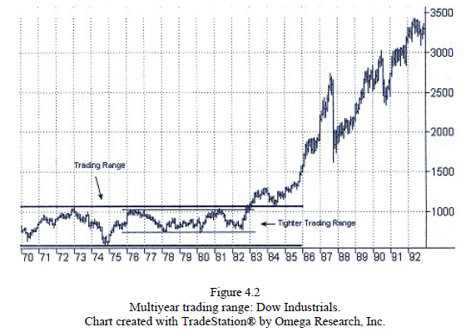
Technical Analysis
Trading ranges can be used to predict breakouts towards the side of the range where the initial breakout occurs. The longer the range means the more significant the breakout could become. Narrow ranges are more reliable.

Slide 12
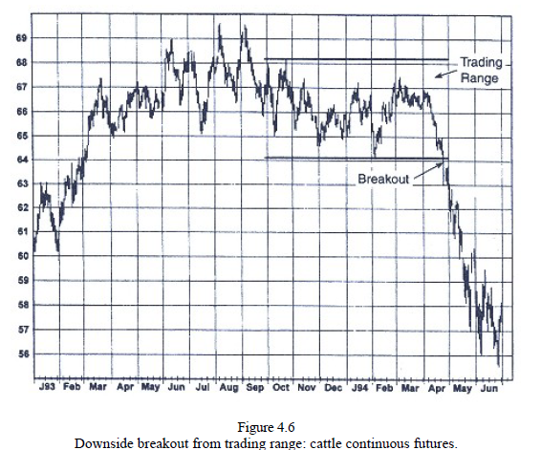
Technical Analysis
False breakouts also exist so it is important to be patient and wait for the stock to break its support or resistance.

Slide 13
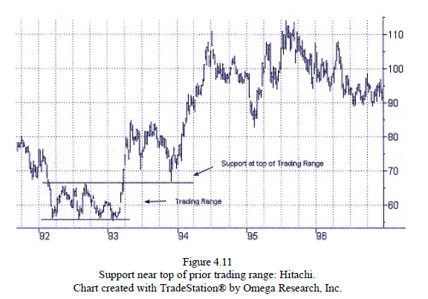
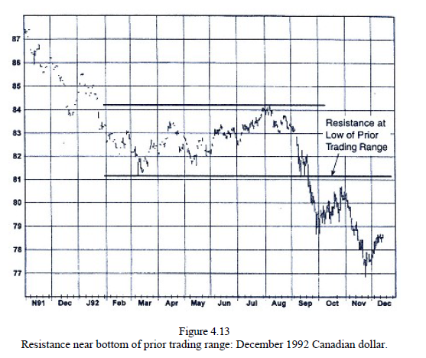
Technical Analysis

Slide 14
Challenges
Some of the challenges we faced include:
Choosing our data set was challenging. We went back and forth on the two sets we found, however we ended up learning from both. (In the end, we chose Historical daily prices of Nasdaq-traded stocks and ETFs)
Figuring out the framework and the method we wanted to implement. Eventually we settled on a recurring neural network method, in which we utilized the output activations from one or more layers of the network by saving the activations.
Mapping market emotions was a much more difficult concept than we anticipated.
Teaching a deep learning model Technical Analysis is possible but has proven to be cumbersome
The Monte Carlo method could be applied without necessarily using deep learning.
A lot more difficult of an issue to tackle than we originally thought.

Slide 15
Abstract
Our primary focus for this task is to utilize machine learning to predict graphs based on results from older stock market data. A level of technical analysis will be needed for adequate implementation for designing the model to create accurate results and meaningful data of which we could gleam information upon finished training.
Our approach has been to utilize Long Short Term Memory (LSTM). Essentially composing cells as an assembly of input gates, output gates, and forget gates. The idea behind this is for memory to be stored in the cell for future use. The gates feed information to each other and regulate passing values through their network (multilayer neural network). This is short term memory that basically lasts for a long period of time (values and information are retained within the gates/cells)

Slide 16
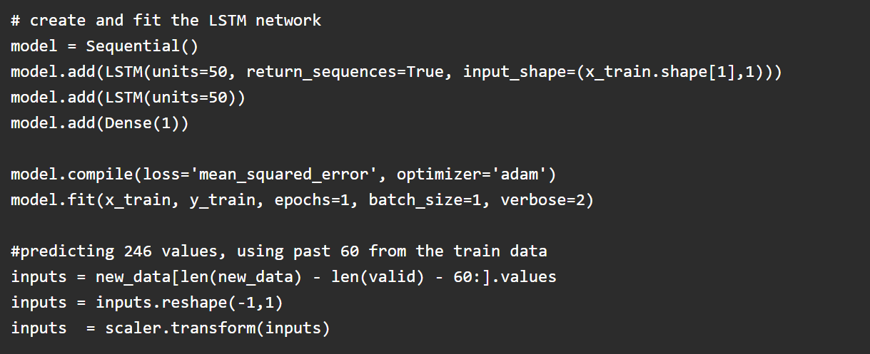
Related Works
https://www.analyticsvidhya.com/blog/2018/10/predicting-stock-price-machine-learningnd-deep-learning-techniques-python/
This project used different machine learning and deep learning models to try and make accurate stock predictions.
Notes:
https://www.analyticsvidhya.com/blog/2018/10/predicting-stock-price-machine-learningnd-deep-learning-techniques-python/
https://medium.datadriveninvestor.com/predicting-the-stock-market-with-python-bba3cf4c56ef
https://deepnote.com/@deepnote/Stock-Analysis-in-Python-4cf17a26-d9bd-420a-a356-74d668ece385
https://www.kaggle.com/code/thebrownviking20/intro-to-recurrent-neural-networks-lstm-gru/notebook
https://www.kaggle.com/code/artemburenok/stock-analysis-monte-carlo-build-portfolio/notebook

Slide 17
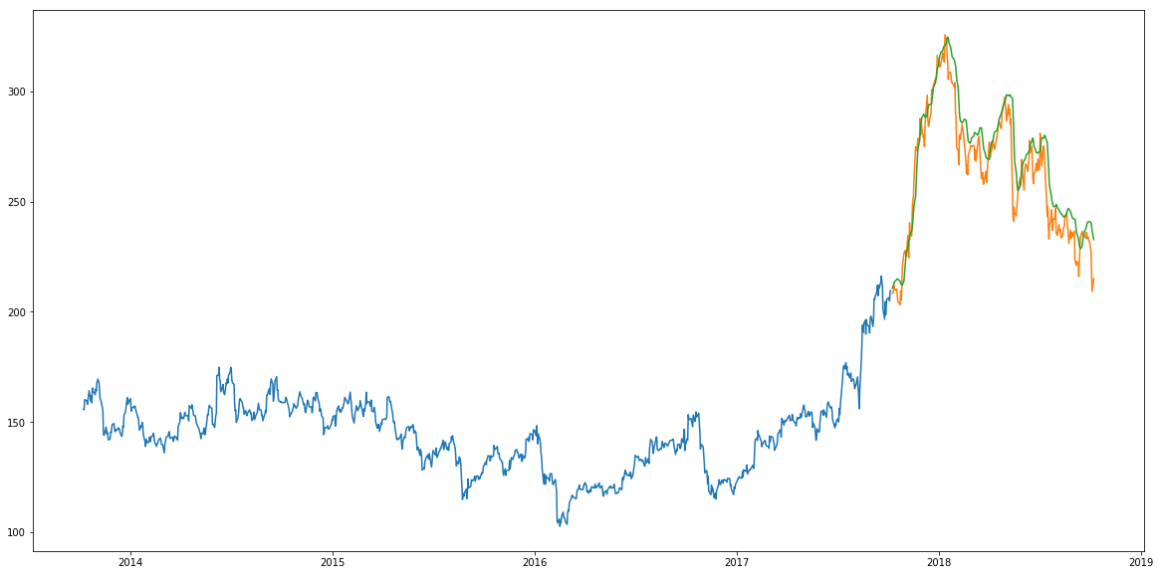
Related Works
LSTM model prediction graph:
Notes:
Orange line is the prediction.

Slide 18
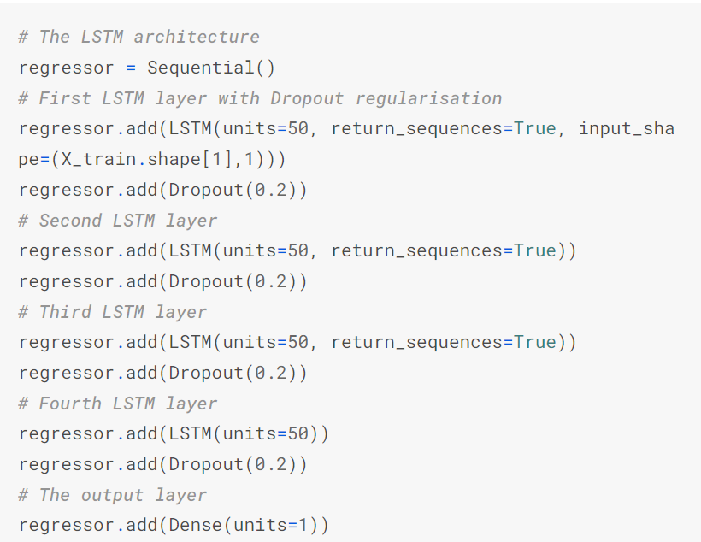
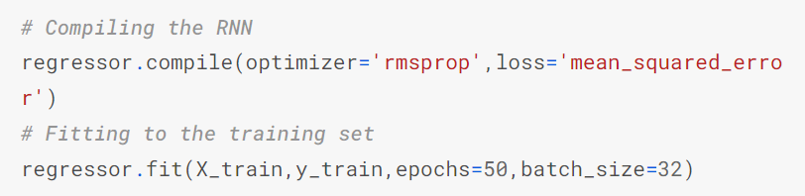
Related Works
https://www.kaggle.com/code/thebrownviking20/intro-to-recurrent-neural-networks-lstm-gru/notebook
This project showed an introduction to using LSTM’s to predict stock movement.

Slide 19
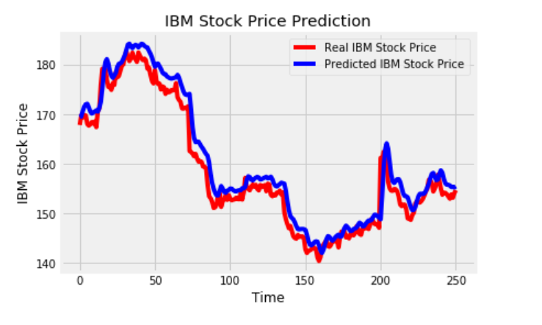
Related Works
LSTM model prediction graph:

Slide 20
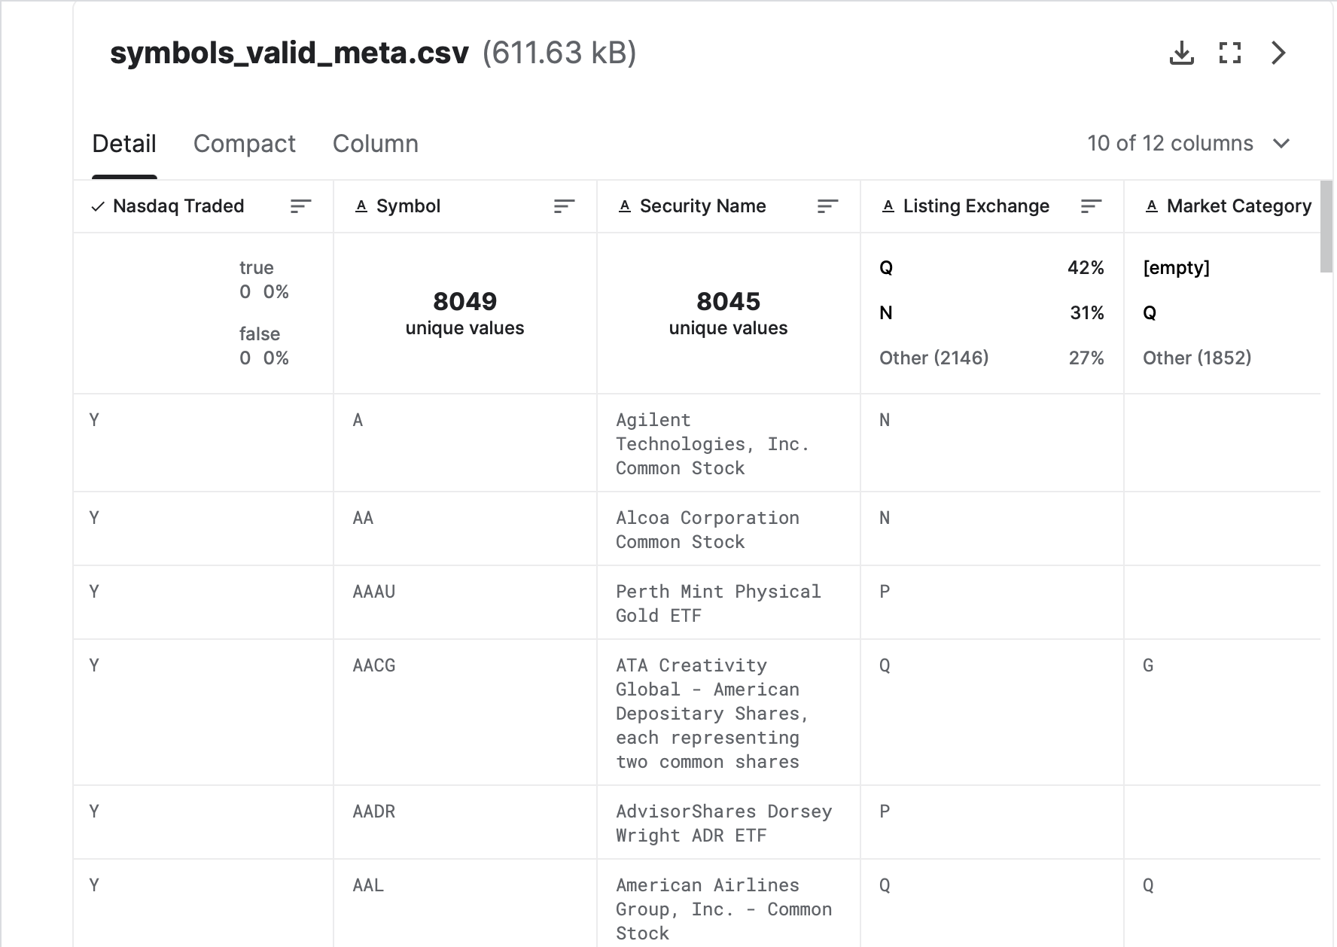
Data
Settled on “Historical daily prices of Nasdaq-traded stocks and ETFs”
Granular data set
Thorough documentation & structure
Quarterly update frequency
Easy to utilize and integrate

Slide 21
Methods
We will modify one of our related works to better improve and visualize the model. The original code only uses LSTM and GRU models along with a single graph to show accuracy. We can utilize our knowledge of BiLSTM, Stacked BiLSTM, histograms, and other models/visualizations to better assess how well our model is doing. We will refine our parameters and attempt to obtain faster runtimes

Slide 22
Experiments
We will experiment by tweaking our model’s structure and hyperparameters to reduce the rsme value as much as possible. We can also implement ROC-AUC graphs to better understand our model’s performance. Overall we need to make sure the model predicts well in a short window of time. If we look at it from too far away we may miscalculate how accurate it really is.

Slide 23
Conclusion
Results are pending completion of code and experimentation. Obvious areas where our work could be expanded is training a separate model in some standardized Technical Analysis calculations to see which predictions are more accurate at predicting future results.

Slide 24
Any Questions?
Notes:
https://colab.research.google.com/drive/1SlP1Vg2KYmqO2qMMQGdV9aWxLzehsBUO?usp=sharing

